Slide 1
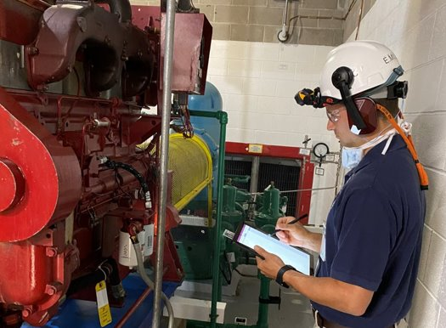

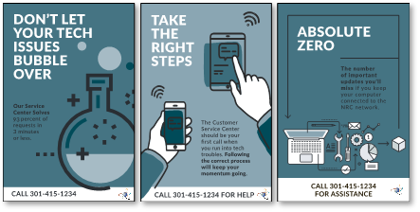
Envisioning the Future
What does NRC have planned to continue to improve the customer experience?
Improving our customer communications through new Marketing and Branding activities to create a holistic experience
Expanding on Customer Outreach initiatives, such as Journey Mapping Workshops or 2-in-1 Pilot to gather more data on the customer experience
Providing more agile support for customers through an IT Customer Self-Service Q&A Bot that will tie together disparate knowledge management sources
5

Slide 2

Key Achievements
We are proud of our OCIO team!
6

Slide 3
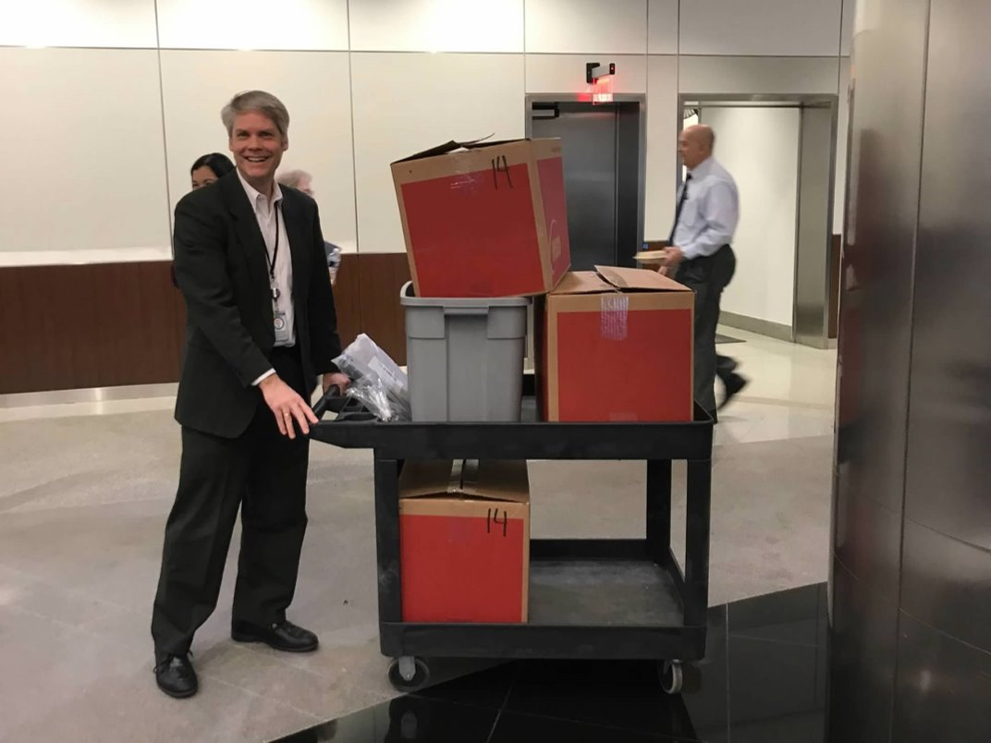
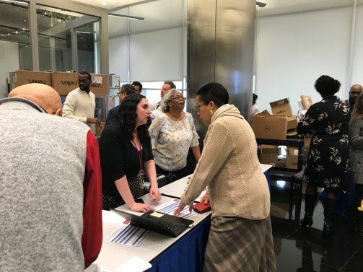
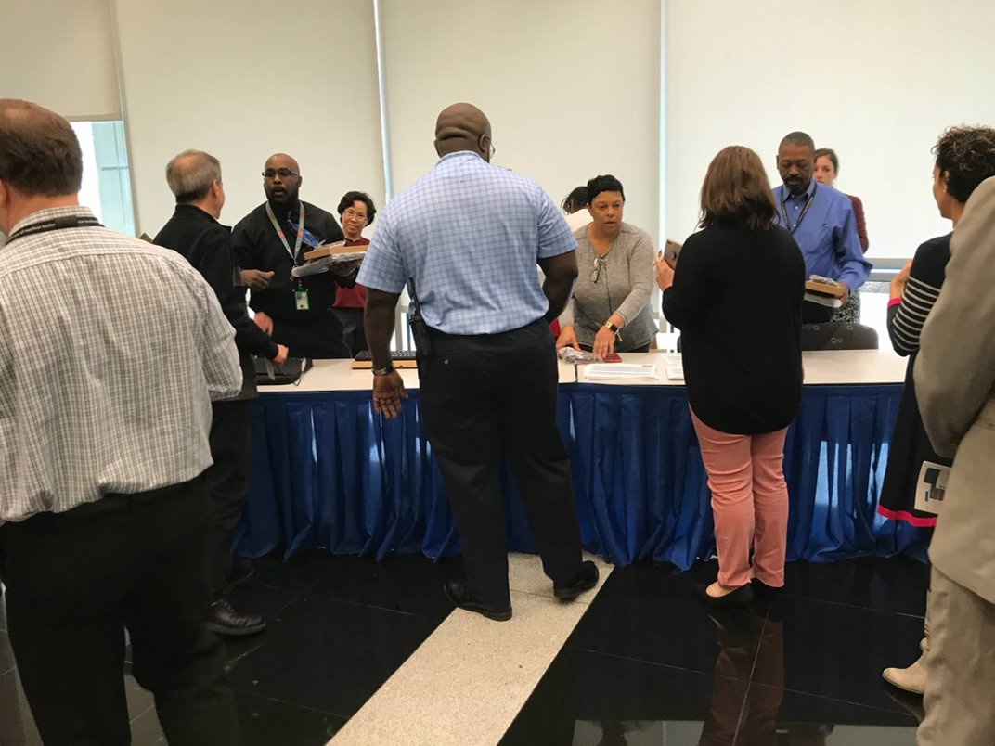
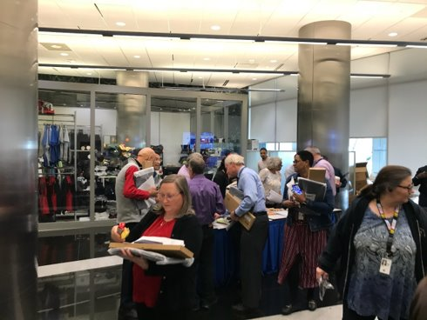
Key Achievements – Prepping for Remote Work
7

Slide 4
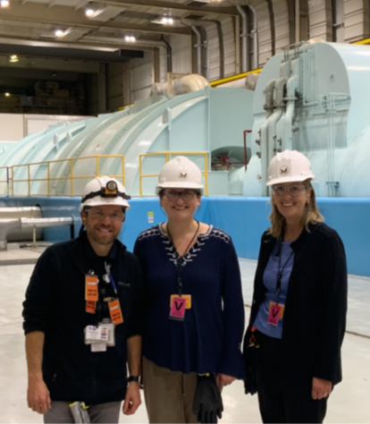
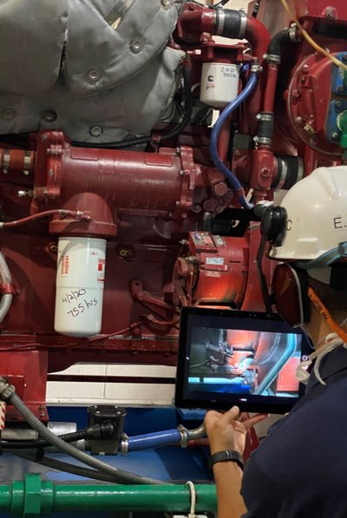
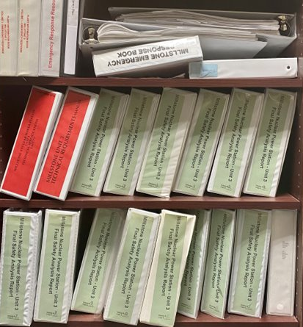
Key Achievements – Resident Inspector Support
8

Slide 5
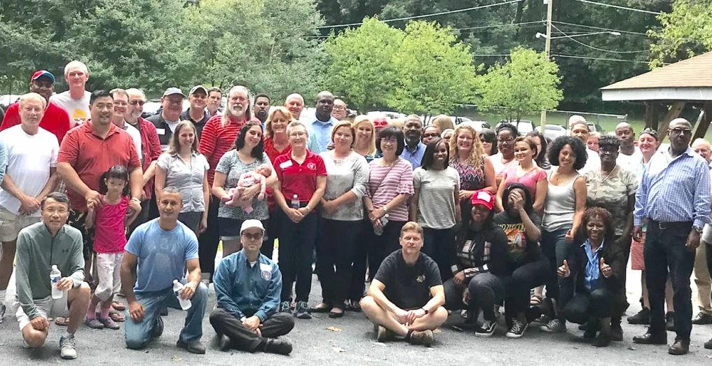
Key Achievements – Our Team
9

